Slide 1




DATA ANALYTICS PROJECT
By Hieu Nguyen

Slide 2

AGENDA
Problem statement
About data
Key findings
Summary
Remarks

Slide 3
Department of Streets and Sanitation (DSS) is a government agency that keeps the streets and alleys of Chicago safe & clean. DSS has more than 2,000 employees that respond to 311 non-emergency service requests.
DSS deals with 400,000+ requests in a year and has a relatively high overall ticket closing time. With limited resources, they need to know which services are struggling and where to prioritize improving first.
By analyzing the data, my main goal is to help them allocate resources effectively to improve their overall resolution time and better fulfil the community’s needs.
PROBLEM STATEMENT

Slide 4
ABOUT DATA
Chicago city 311 service data
Data coverage: between 2018 and 2020 (not 3 full years)
Data size: 2.8 million rows, 15 columns (around 740,000 rows for DSS)
Fields: ticket category, agency, created date, close date, address, community area, etc.

Slide 5
What make a service category more important and more urgent than others?
LOW/NOT A PRIORITY | *HIGH PRIORITY
NOT A PRIORITY | LOW PRIORITY
Priority Metrics
IMPORTANCE (Volume)
URGENCY (Time to Close)

Slide 6
3 HIGH PRIORITY
180000
160000
140000
120000
Priority Categories
100000
Total Ticket Count
Garbage Cart Maintenance (26, 86k)
80000
Tree Trim Request
(118, 66k)
60000
40000
Tree Removal Request
(120, 32k)
20000
0
0 10 20 30 40 50 60 70 80 90 100 110 120 130 140 150 160 170 180 190 200 210 220 230 240
Avg Days to Close

Slide 7
How can we tell if these 3 services are problematic?
A cross checking with New York City 311 data for similar services shows that:
NYC’s garbage-cart-related tickets have an average close time of ^{1-3 days .}
  Compared to 26 days for Chicago.
NYC’s tree-related tickets have an average close time of ^{20-60 days.}
  Compared to 120 days for Chicago.
Validate Findings

Slide 8
Do all tickets have longer close time than NYC’s?
Close Time Distribution
39113
Garbage Cart Maintenance
Tree Trim Request
Tree Removal Request
Close Time Distribution
27297
Number of Tickets
22385
14476
13531
10785
8788
4381
5315
4714
5874
3111
4009
2703
658
Within 1 week
1-4 weeks
1-2 months
2-3 months
More than 3 months

Slide 9
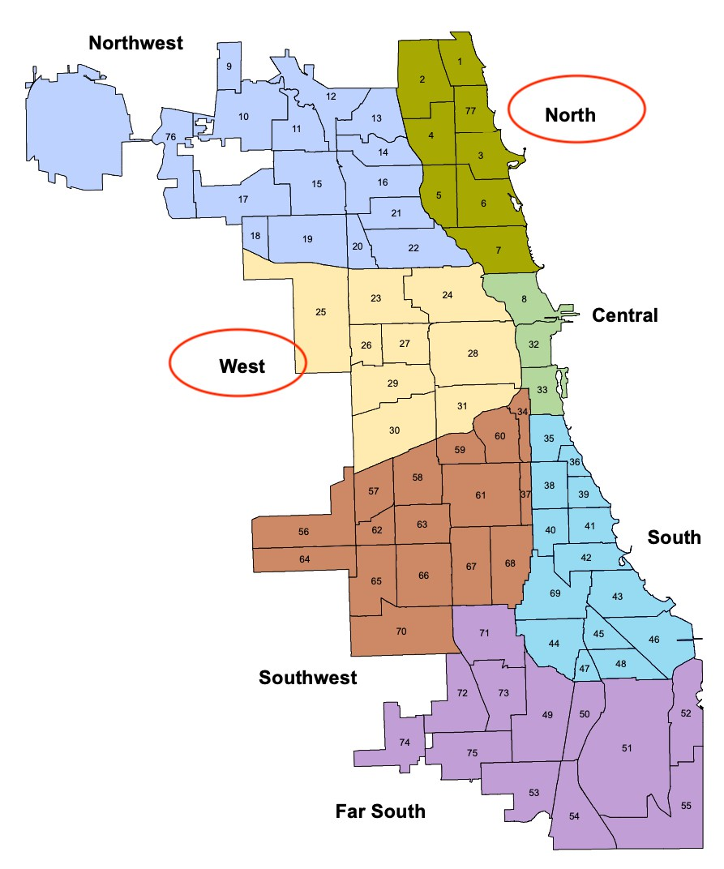
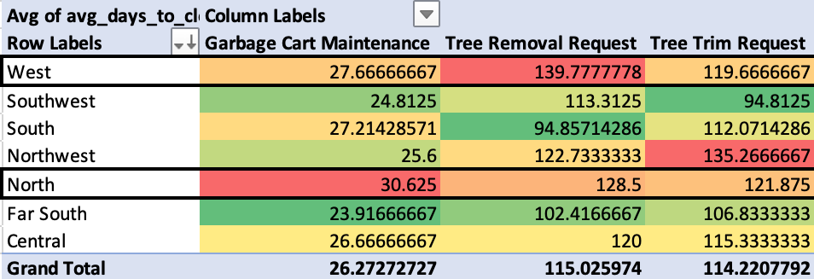
Which regions are struggling more than others?
Priority Regions

Slide 10
Prioritize Garbage Cart Maintenance, Tree Trim, and Tree Removal Request since they have both high volume and close time. About 50% of more tickets within these categories have average close time much longer than NYC’s.
Allocate more resources to the North and the West region as they have among the longest close time in all 3 prioritized categories. Regardless, the close time in all regions are still significantly higher than the standard.
It would be helpful to understand what NYC is doing differently to resolve tickets in much shorter time, also to further investigate how a large portion of DSS tickets were closed faster than the average.
Depending on the investigation, DSS should consider investing in better equipment, improving work efficiency, and balancing the number of staff in different locations to reduce the overall resolution time.
SUMMARY

Slide 11


ADDITIONAL REMARKS
Find more relevant data that might explain the longer time to close in certain regions and community areas such as number of trees, size of trees, number of DSS offices or employees covering the area, number of garbage carts, agency’s budget, etc.
Identify frequency patterns in month or days of the week for the 3 focused categories to help DSS plan their resources for the whole year.

